Slide 1
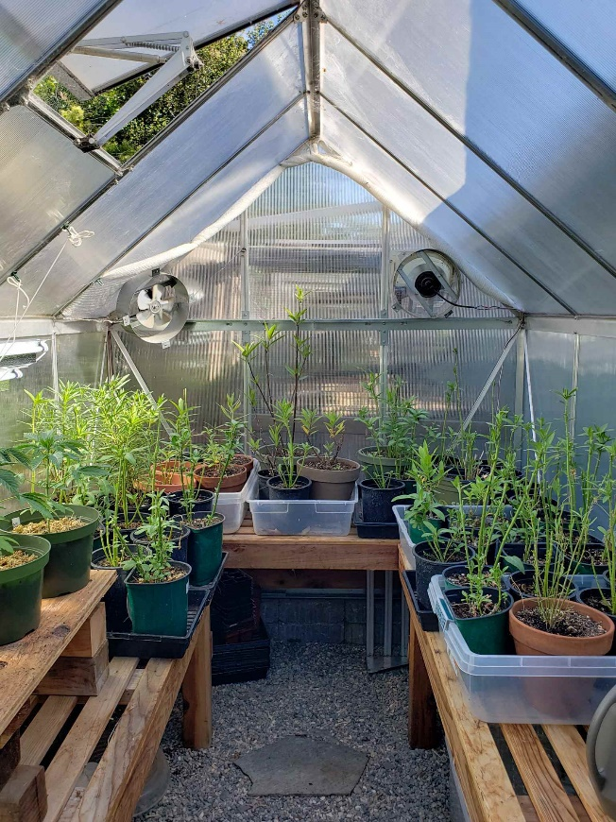
Automatic Greenhouse Ventilation
Mini Project – Wokwi Based IoT Application Development
IOT Level-2
Type: Simulation
By: Khaushl Dev Saravanan
Registration No.: 230968198
Subject Code: DSE 4406

Slide 2
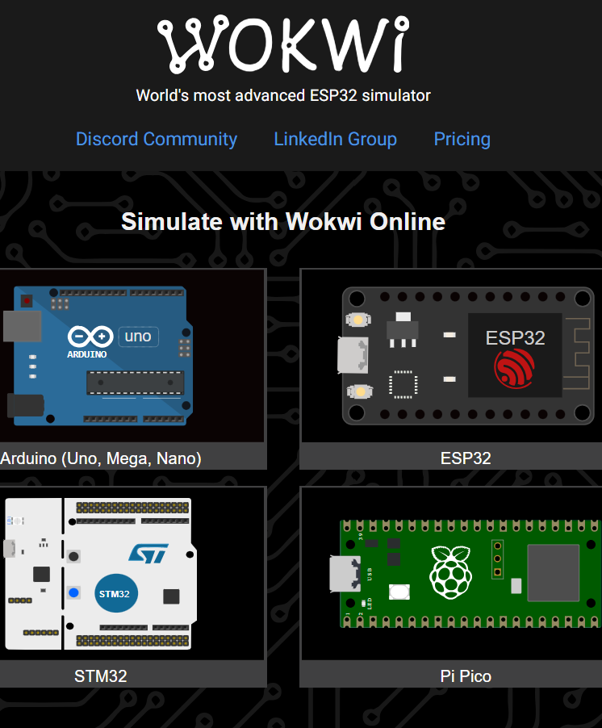
2.1 What is Wokwi?
Wokwi is an online simulation platform designed for electronics and IoT projects.
It allows users to virtually build, test, and debug circuits using microcontrollers like Arduino, ESP32, and Raspberry Pi.
It supports collaboration and sharing of projects, enabling students and developers to visualize and troubleshoot circuits before moving to real hardware.

Slide 3
2.2 Supported boards and components:
a.) Microcontroller Boards:
Arduino Uno (ATmega328P)
Arduino Nano
Arduino Mega (ATmega2560)
ESP32 family (ESP32, ESP32-S2, ESP32-S3)
ESP32-C3 / C6 / H2
Raspberry Pi Pico (RP2040)
ATtiny85
STM32 boards (e.g., STM32F103, STM32C031)
b.) Sensors:
DHT22 temperature & humidity sensor
HC-SR04 ultrasonic distance sensor
PIR motion sensor
DS18B20 temperature sensor
Photoresistor (LDR) light sensor
MQ-2 gas sensor
BMP180 pressure sensor
MPU6050 accelerometer + gyroscope
c.) Input Components:
Push buttons
Slide switches
4×4 keypad
Potentiometers
Rotary encoder
Analog joystick
d.) Displays:
LCD 1602 (16×2 LCD)
LCD 2004 (20×4 LCD)
SSD1306 OLED display
Nokia 5110 LCD
Seven-segment displays
LED matrix (MAX7219)
e.) Actuators:
Standard LEDs / RGB LEDs
Servo motors
Stepper motors
Buzzers
Relay modules
f.) Other Electronic Components:
Resistors
Breadboards
Shift registers (74HC595, 74HC165)
MicroSD card module
Logic analyzer

Slide 4
2.3 Steps Followed:
Account Creation – Signed up on the Wokwi platform to access the simulation tools.
Creating a New Project – Started a new project workspace for the intended IoT/circuit application.
Adding Components – Selected and placed the required microcontroller, sensors, actuators, and other electronic components.
Connecting the Circuit – Made virtual connections between components using wires, simulating a real circuit setup.
Writing Code – Programmed the microcontroller using ESP32 to control the sensors and actuators.
Running Simulation – Tested and observed the behavior of the circuit in real time, debugging and modifying code as needed.

Slide 5
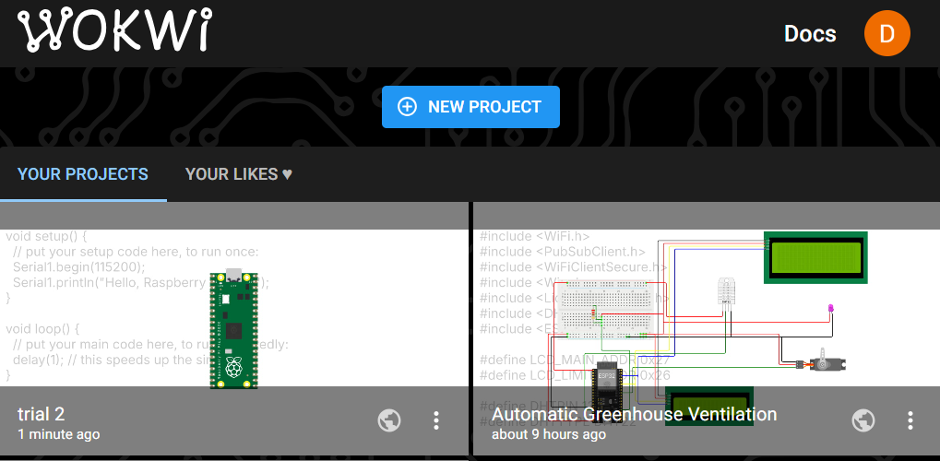
2.4 Project Dashboard

Slide 6
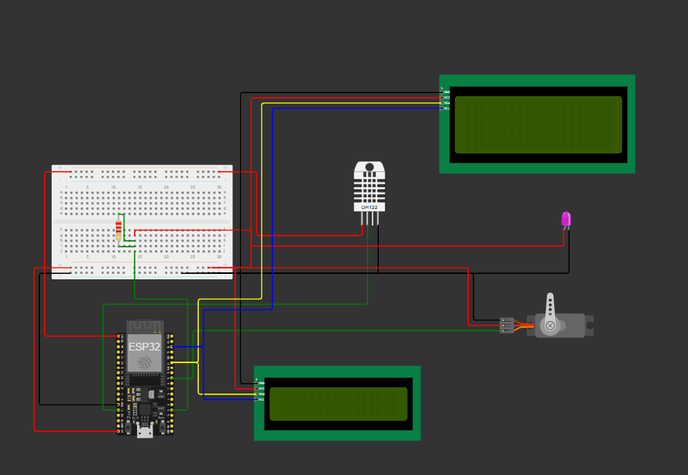
2.5 Circuit Layout:

Slide 7
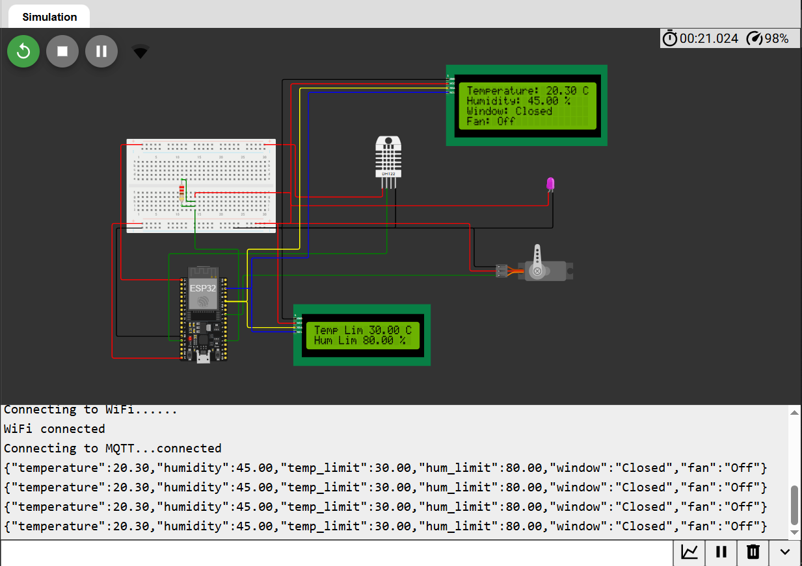

2.6 Running Simulation:

Slide 8
3. Problem Statement:
Real-World Problem:
Greenhouses require precise control of temperature and humidity to support healthy plant growth. Manual monitoring and ventilation are time-consuming, error-prone, and may lead to overheating or excessive humidity, which can damage crops and reduce yield.
Need for Automation:
Automating greenhouse ventilation allows continuous, real-time monitoring and control of environmental conditions. The system should adapt to different plants or seasonal changes without physical action/intervention. Also allows control and monitoring while away from home.
Target Environment:
This system is designed for small to medium-sized greenhouses where temperature and humidity fluctuate due to sunlight, weather, or seasonal variations. It is particularly useful in areas with limited labor availability or for growers who want precise climate control.
Expected Outcome:
The automated system maintains temperature and humidity within user-defined thresholds by controlling the window via a servo motor and activating a fan/LED indicator when needed. Real-time readings and set limits are displayed on two LCDs and the Dashboard, ensuring optimal plant growth, improved yield, and reduced human effort.

Slide 9
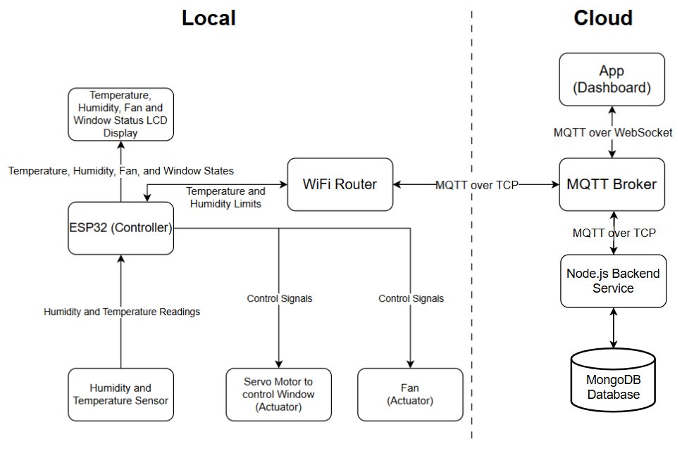
Architecture Diagram:
4. IOT Level Identification:
Application Layer
Level: Level 2 – Local Analysis and Cloud Application
Justification: Sensing and processing occurs locally. Control, application, and data storage in the cloud.
Network Layer
Perception Layer

Slide 10
Explanation:
DHT22 sensor measures real-time temperature and humidity.
ESP32 compares these readings with the user-defined thresholds.
When limits are exceeded, it actuates the servo motor to open/close the window and switches fan(LED) on/off.
The main LCD shows the current environmental conditions and actuator states.
The limit LCD shows the thresholds set by the user via the cloud application.
The dashboard in the cloud allows the user to monitor the state of the system and set the temperature and humidity limits dynamically.
The data is stored in a MongoDB database through the Node.js backend.

Slide 11
Sl. No.: | Component: | Type: | Role:
1. | ESP32 | Processing Unit | Microcontroller that processes sensor data and controls actuators/LCDs
2. | DHT22 Sensor | Sensor | Measures temperature and humidity
3. | Servo Motor | Actuator | Opens/closes the greenhouse window
4. | Fan (represented by LED) | Actuator | Provides ventilation inside the greenhouse
5. | 20x4 LCD Display (Main) | Output Device | Shows current temperature, humidity, window, and fan states
6. | 16x2 LCD Display (Limit) | Output Device | Displays user-set temperature and humidity limits
7. | Breadboard | Connector Platform | Provides easy wiring and connections between components
8. | Resistor | Passive Component | Limits current to protect LED
9. | Power Supply | Power Source | Provides required voltage/current to ESP32, actuators, and sensors.
5. Components Used:

Slide 12
ESP32 Pin: | Connected Devices: | Mode: | Purpose:
GPIO pin 13 | DHT22 SDA (Digital data pin) | Input | To receive temperature and humidity data from the DHT22 sensor.
GPIO pin 2 | LED | Output | Indicates when the ventilation fan is activated.
GPIO pin 18 | Servo Motor (PWM servo control signal) | Output | Controls the opening and closing of the greenhouse window for ventilation.
3.3 V and 5V pins | Power Supply | Power Output | Supplies power to sensors, LCDs, LED, and Servo motor.
GND1 (ground) | Ground | Power Reference | Completes the electrical circuit and provides a common reference voltage for all components.
GPIO pin 21 | I2C SDA (LCD data line) | Communication | Transfers data between the ESP32 and the I²C LCD displays.
GPIO pin 22 | I2C SCL (LCD clock line) | Communication | Provides the clock signal that synchronizes data transfer between the ESP32 and the LCD displays.
6. Pin Configuration:
Notes:
GPIO = General Purpose Input Output Pins
*Note: I²C (Inter-Integrated Circuit) is a serial communication protocol used to connect multiple electronic devices using only two wires. These wires are SDA (Serial Data) and SCL (Serial Clock). The SDA line carries the data between devices, while the SCL line provides the clock signal that synchronizes communication. Each device on the I²C bus has a unique address, allowing the microcontroller to communicate with multiple components using the same two pins. In Arduino boards such as the Arduino Uno, the I²C pins are A4 (SDA) and A5 (SCL). In this project, I²C communication is used to control the LCD displays efficiently using fewer pins.

Slide 13
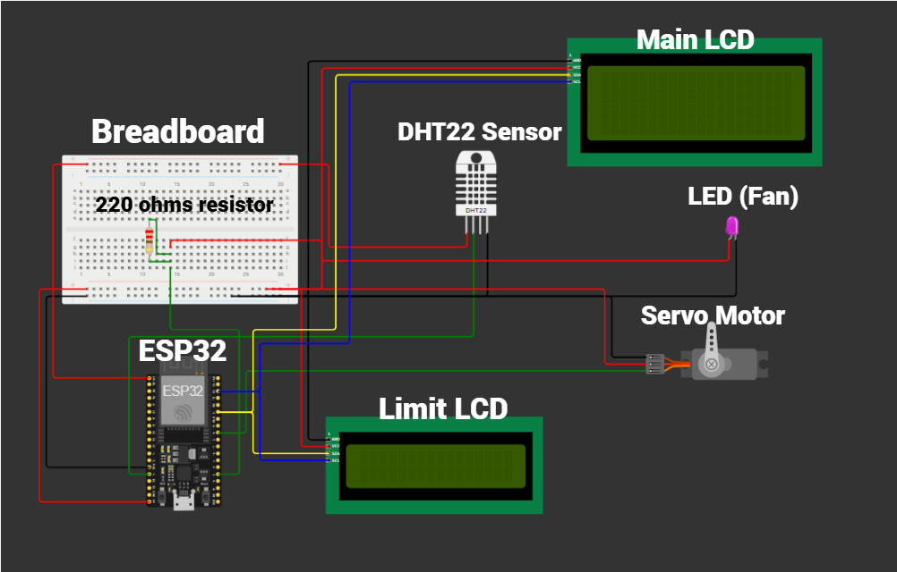
7. Circuit Diagram:

Slide 14
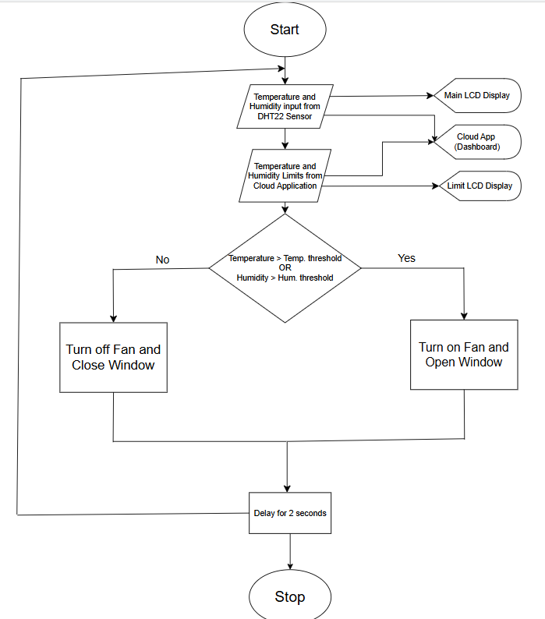
8. Flow Diagram:

Slide 15
9. Event-Insight-Action:
Event: The DHT22 sensor detects the current temperature and humidity inside the greenhouse. At the same time, the app provides the user-defined temperature and humidity limits.
Insight:
The ESP32 processes the sensor data and compares the measured temperature and humidity with the limits set by the user. It determines whether the environmental conditions exceed the safe thresholds.
Action:
If the temperature or humidity exceeds the set limits, the servo motor opens the greenhouse window, and the fan (LED indicator) turns ON to increase ventilation. If the conditions are within limits, the window closes and the fan turns OFF. The system also displays the readings and system status on the LCD displays and sends the information to the app.

Slide 16
Wireless Communication:
Between the ESP32 and MQTT broker: (MQTT over TCP with TLS, encrypted)
ESP32 is connected to WOKWI virtual Wi-Fi router
ESP32 publishes sensor data (json string) to broker with topic greenhouse/sensor1
ESP32 is subscribed to topics greenhouse/control/temp_limit and greenhouse/control/humidity_limit
Between the MQTT broker and the Mobile App client: (MQTT over WebSocket with TLS)
App is subscribed to topic greenhouse/sensor1 (receives json string)
App publishes user-defined limits (string) to broker with topics greenhouse/control/temp_limit and greenhouse/control/humidity_limit
WSS (WebSocket Secure) runs on top of TCP and provides a persistent bidirectional connection, over which mqtt messages are transmitted.

Slide 17
10. Program Code:
#include <WiFi.h>
#include <PubSubClient.h>
#include <WiFiClientSecure.h>
#include <Wire.h>
#include <LiquidCrystal_I2C.h>
#include <DHT.h>
#include <ESP32Servo.h>
#define LCD_MAIN_ADDR 0x27
#define LCD_LIMIT_ADDR 0x26
#define DHTPIN 13
#define DHTTYPE DHT22
#define LED_PIN 2
#define SERVO_PIN 18
const char* ssid = "Wokwi-GUEST";
const char* password = "";
const char* mqtt_server = "e340023a50cf44689effff5f4b6b0a62.s1.eu.hivemq.cloud";
const int mqtt_port = 8883;
const char* mqtt_user = "esp32";
const char* mqtt_pass = "w@4$Y82+86*8^8b";

Slide 18
10. Program Code:
WiFiClientSecure espClient;
PubSubClient client(espClient);
LiquidCrystal_I2C lcdMain(LCD_MAIN_ADDR, 20, 4);
LiquidCrystal_I2C lcdLimit(LCD_LIMIT_ADDR, 16, 2);
DHT dht(DHTPIN, DHTTYPE);
Servo windowServo;
float temperature = 0;
float humidity = 0;
float temperature_limit = 30;
float humidity_limit = 80;
String windowState = "Closed";
String fanState = "Off";
void callback(char* topic, byte* payload, unsigned int length) {
String message = "";
for (int i = 0; i < length; i++) {
message += (char)payload[i];
}
if (strcmp(topic, "greenhouse/control/temp_limit") == 0) {
temperature_limit = message.toFloat();
}
if (strcmp(topic, "greenhouse/control/humidity_limit") == 0) {
humidity_limit = message.toFloat();
}
}
Notes:
9600 baud rate means 9600 bits per second are transmitted.

Slide 19
10. Program Code:
void setup_wifi() {
Serial.print("Connecting to WiFi");
WiFi.begin(ssid, password);
while (WiFi.status() != WL_CONNECTED) {
delay(500);
Serial.print(".");
}
Serial.println("\nWiFi connected");
}
void reconnect() {
if (!client.connected()) {
Serial.print("Connecting to MQTT...");
String clientId = "ESP32-" + String(random(0xffff), HEX);
if (client.connect(clientId.c_str(), mqtt_user, mqtt_pass)) {
Serial.println("connected");
client.subscribe("greenhouse/control/temp_limit");
client.subscribe("greenhouse/control/humidity_limit");
} else {
Serial.print("failed, rc=");
Serial.print(client.state());
Serial.println(" retrying in 2s");
delay(2000);
}
}
}

Slide 20
10. Program Code:
void setup() {
Serial.begin(115200);
lcdMain.init();
lcdMain.backlight();
lcdLimit.init();
lcdLimit.backlight();
dht.begin();
pinMode(LED_PIN, OUTPUT);
windowServo.attach(SERVO_PIN);
Wire.begin(21, 22);
setup_wifi();
espClient.setInsecure();
client.setServer(mqtt_server, mqtt_port);
client.setCallback(callback);
client.setBufferSize(512);
}
void loop() {
if (WiFi.status() != WL_CONNECTED) {
setup_wifi();
}
if (!client.connected()) {
reconnect();
}

Slide 21
10. Program Code:
client.loop();
temperature = dht.readTemperature();
humidity = dht.readHumidity();
if (isnan(temperature) || isnan(humidity)) {
Serial.println("DHT read failed");
delay(2000);
return;
}
if (temperature > temperature_limit || humidity > humidity_limit) {
windowServo.write(90);
digitalWrite(LED_PIN, HIGH);
windowState = "Open";
fanState = "On";
} else {
windowServo.write(0);
digitalWrite(LED_PIN, LOW);
windowState = "Closed";
fanState = "Off";
}
String payload = "{";
payload += "\"temperature\":" + String(temperature) + ",";
payload += "\"humidity\":" + String(humidity) + ",";
payload += "\"temp_limit\":" + String(temperature_limit) + ",";
payload += "\"hum_limit\":" + String(humidity_limit) + ",";
payload += "\"window\":\"" + windowState + "\",";
payload += "\"fan\":\"" + fanState + "\"";
payload += "}";
client.publish("greenhouse/sensor1", payload.c_str());

Slide 22
10. Program Code:
lcdMain.setCursor(0, 0);
lcdMain.print("Temperature: ");
lcdMain.print(temperature);
lcdMain.print(" C ");
lcdMain.setCursor(0, 1);
lcdMain.print("Humidity: ");
lcdMain.print(humidity);
lcdMain.print(" % ");
lcdMain.setCursor(0, 2);
lcdMain.print("Window: ");
lcdMain.print(windowState);
lcdMain.print(" ");
lcdMain.setCursor(0, 3);
lcdMain.print("Fan: ");
lcdMain.print(fanState);
lcdMain.print(" ");
lcdLimit.setCursor(0, 0);
lcdLimit.print("Temp Lim ");
lcdLimit.print(temperature_limit);
lcdLimit.print(" C ");
lcdLimit.setCursor(0, 1);
lcdLimit.print("Hum Lim ");
lcdLimit.print(humidity_limit);
lcdLimit.print(" % ");
Serial.println(payload);
delay(2000);
}

Slide 23
11. Simulation Output:
a.) When the temperature or humidity thresholds are not crossed:
The fan (pink LED) is off, and the window (servo motor) is closed.

Slide 24
11. Simulation Output:
b.) When the temperature and humidity thresholds are crossed:
The fan (pink LED) is turned on, and the window (servo motor) is opened.

Slide 25
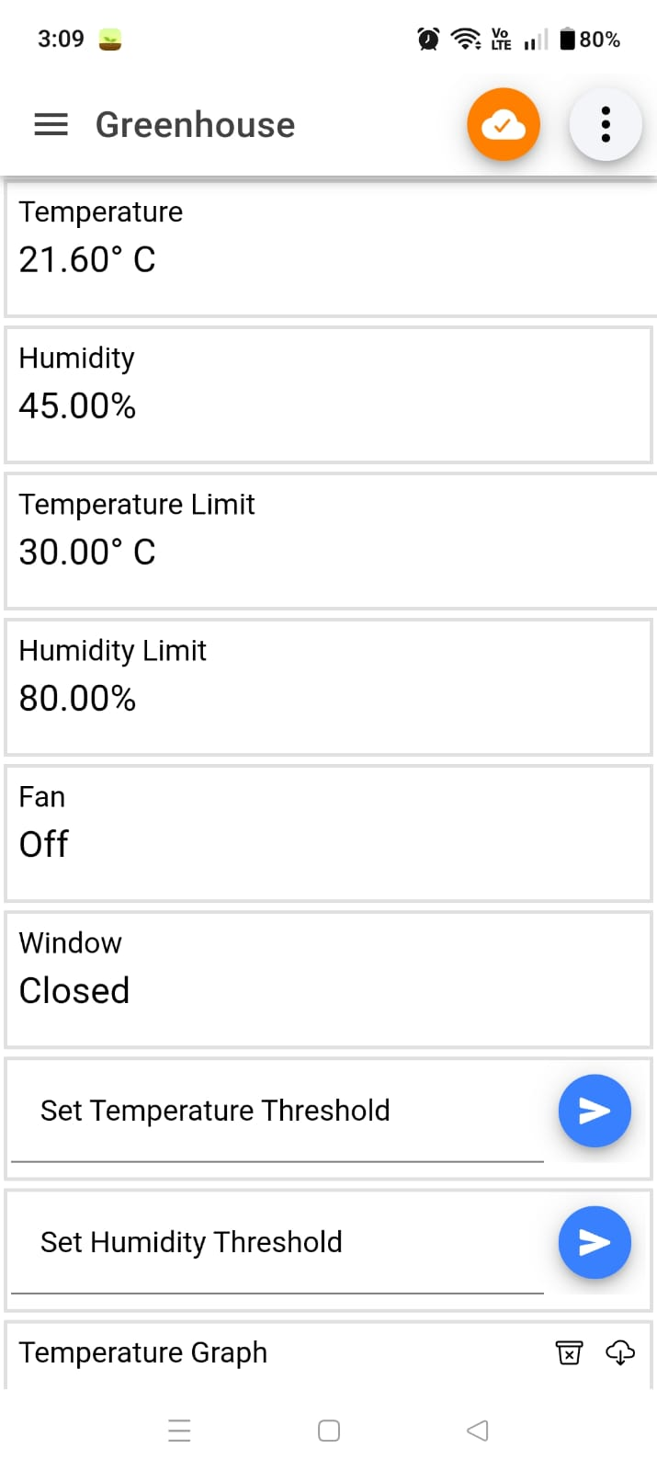
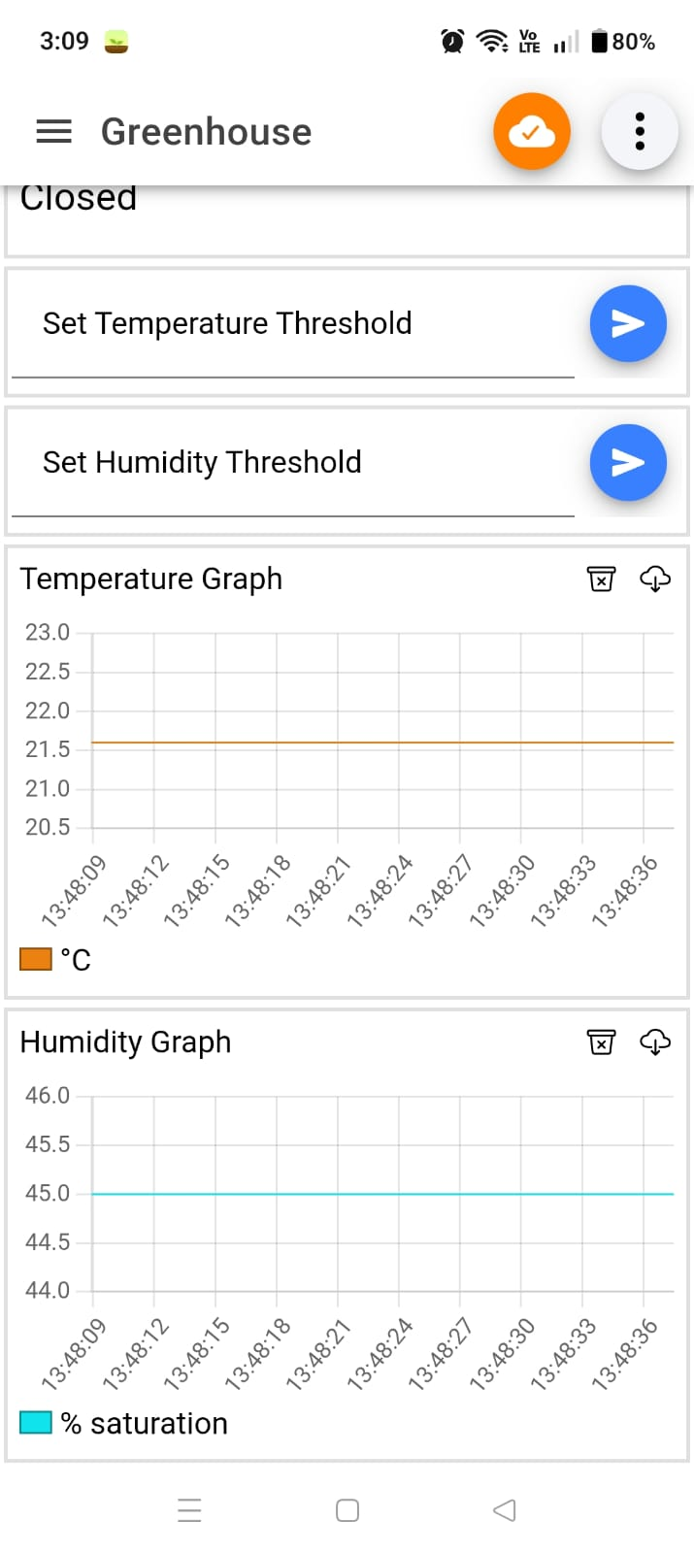
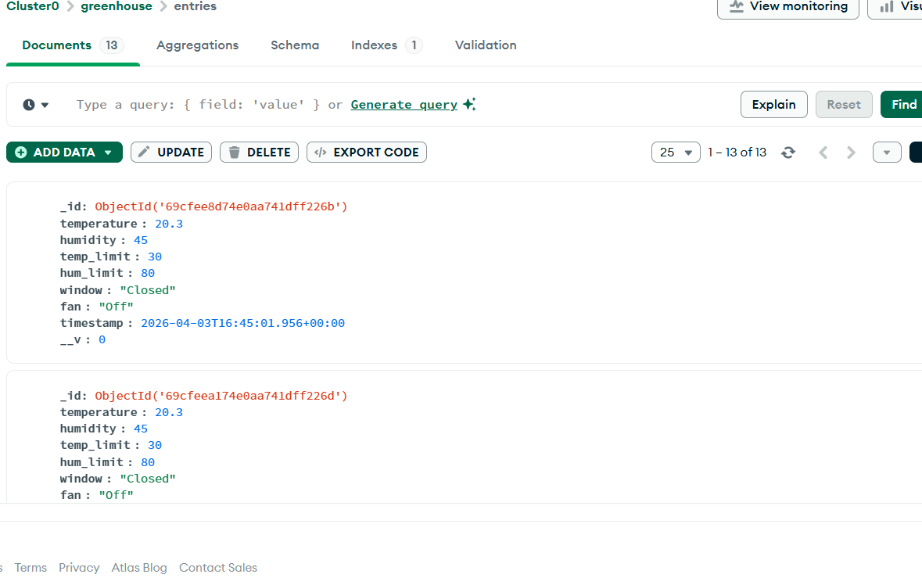
11. Simulation Output:

Slide 26
12. Wokwi Project Link:
https://wokwi.com/projects/460081078946873345

Slide 27
13. Conclusion:
Observations:
The system successfully monitors temperature and humidity using the DHT22 sensor.
Automatic control of ventilation (servo window) and fan (LED) based on threshold limits works reliably.
Limits can be remotely updated via MQTT, enabling real-time control from a mobile app.
Live data publishing to the MQTT broker allows continuous monitoring from the app.
Dual LCDs display real-time sensor data and user-defined limits clearly.
Data is stored in MongoDB every 10 minutes.
Limitations:
Uses a single DHT22 sensor, which may not reflect large greenhouse conditions.
Fan is simulated using an LED instead of a real actuator.
No alert/notification system when thresholds are exceeded.
Basic control logic (no adaptive or intelligent decision-making).

Slide 28
13. Conclusion:
Future Improvements:
Integrate more sensors:
Soil moisture
Light intensity
CO₂ levels
Replace LED with a real fan control circuit (relay).
Add mobile alerts/notifications when limits are exceeded.
Introduce AI/predictive control for optimized plant growth, using historical data.
Expand to multi-zone sensing for larger greenhouse coverage.

Slide 29


